Slide 1
Appliances Energy Prediction
Capstone Project – 2
Appliances Energy Prediction
BY:: GULAM SARVAR

Slide 2
Table of Content
Defining The Problem Dataset Source
Goal of the Project Problem Statement Goal
EDA and Feature Engineering Dataset Summary Dataset Describe
Target and Feature Relation Between the target and other features
Applying the model Applying the different types of Machine Learning Regression model
Results/Conclusion

Slide 3
A. Defining the problem:-
DATASET SOURCE:--
A ZigBee wireless sensor network monitored house temperature and humidity conditions. Each wireless node transmitted the temperature and humidity conditions around 3.3 min. Then, the wireless data was averaged for10 minutes periods. The energy data was logged every 10 minutes with m-bus energy meters. Weather from the nearest airport weather station (Chievres Airport, Belgium) was downloaded from a public data set from Reliable Prognosis (rp5.ru) and merged with the experimental data sets using the date and time column. Two random variables have been included in the data set for testing the regression models and to filter out non-predictive attributes Where indicated, hourly data (then interpolated) from the nearest airport weather station (Chievres Airport, Belgium) was downloaded from a public data set from Reliable Prognosis, rp5.ru. Permission was obtained from Reliable Prognosis for the distribution of the 4.5 months of weather data.

Slide 4
B. Goal of Project:--
Goal:--
The Goal of our project is to predict the energy prediction of appliances in household based on the sensor data, we have from a particular apartment
and corresponding weather report..
Why this is important?
We need to find out the energy consumption of households in the city so as the ensure that the electricity fed into the electricity grid is always be equal to the amount of electricity consumed otherwise there is a possibility of black out

Slide 5
C. EDA and Feature Engineering:-- Data Summary:--
Dataset contain 19735 Rows and 29 Columns, including the one target features and other features.
The Target feature/Dependent variable is 'Appliances‘.
And other is ['date, 'lights', 'T1', 'RH_1', 'T2', 'RH_2', 'T3', 'RH_3', 'T4', 'RH_4', 'T5', 'RH_5', 'T6', 'RH_6', 'T7', 'RH_7', 'T8', 'RH_8', 'T9', 'RH_9', T_out, Press_mm_hg, RH_out, Windspeed, 'Visibility', dewpoint, 'rv1', rv2']
T stands for Temperature, and RH is for Humidity.
Temperature, Humidity is taken from inside and outside location for example:T1, Temperature in kitchen area, in Celsius and RH6, Humidity outside the building (north side)

Slide 6
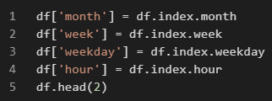
C. EDA and Feature Engineering:-- Description of Dataset:--
Dataset has all features including both dependent and independent dtype : int64.
Dataset has Zero Null or Missing Values so it is easy to deal with it
We have create additional columns , which is derive from ‘Date’ i.e. Month, Week, weekday, hour as shown in the snap
Lets see the different type of relation
In Dependent and Independent Variable

Slide 7
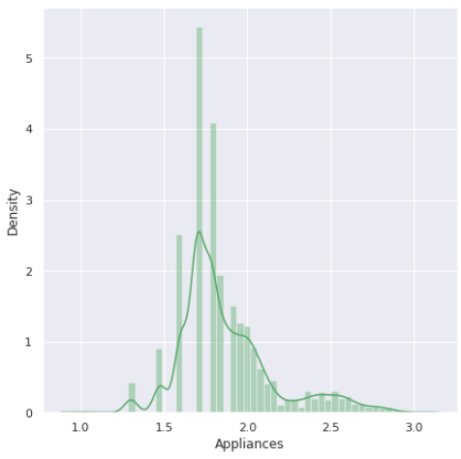
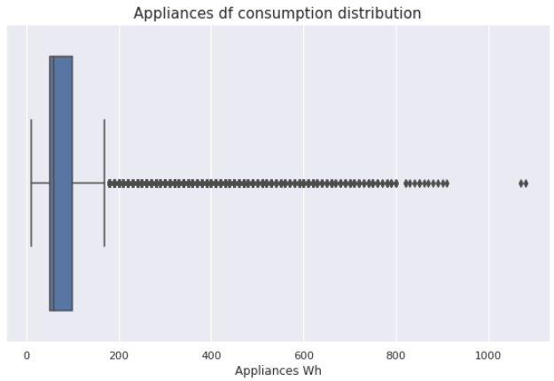
D. Target and Feature:--
Target Variable “Appliances” Data Distribution Plot:--
“Appliances” Data is Skewed
Target Variable “Appliances” Consumptions Plot:--
Outlier Max threshold of Appliances is “50.0”

Slide 8
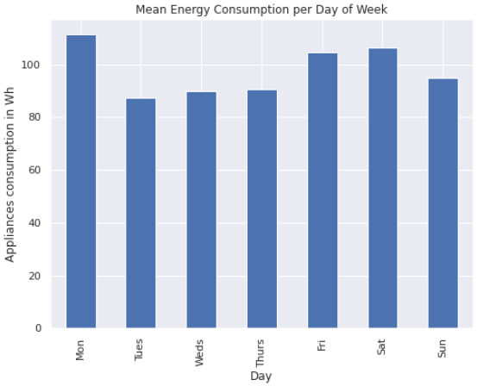
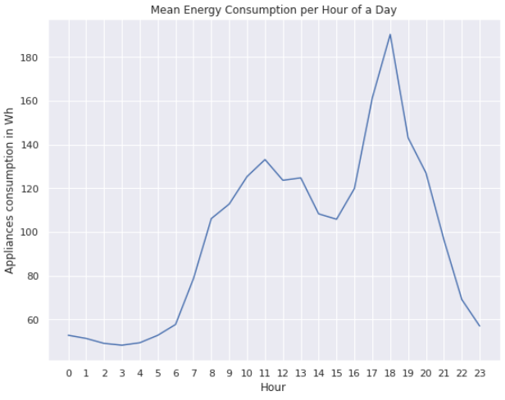
Continued:--
Appliances Energy Consumption each hour of a day
Appliances Energy Consumption per day of a Week

Slide 9
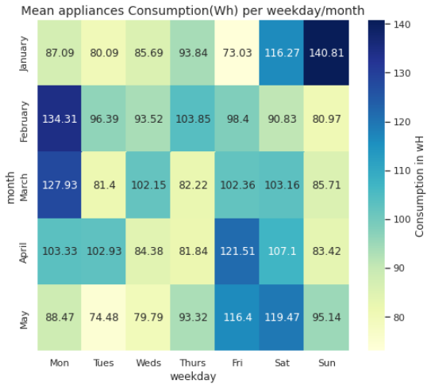
Continued:--
Mean of Appliances Energy consumption is more in winter season for example February March April.
Use of Energy in Watt hour is increases in weekends i.e. Friday and Sunday.
Energy consumption is back to normal in week’s other day.

Slide 10
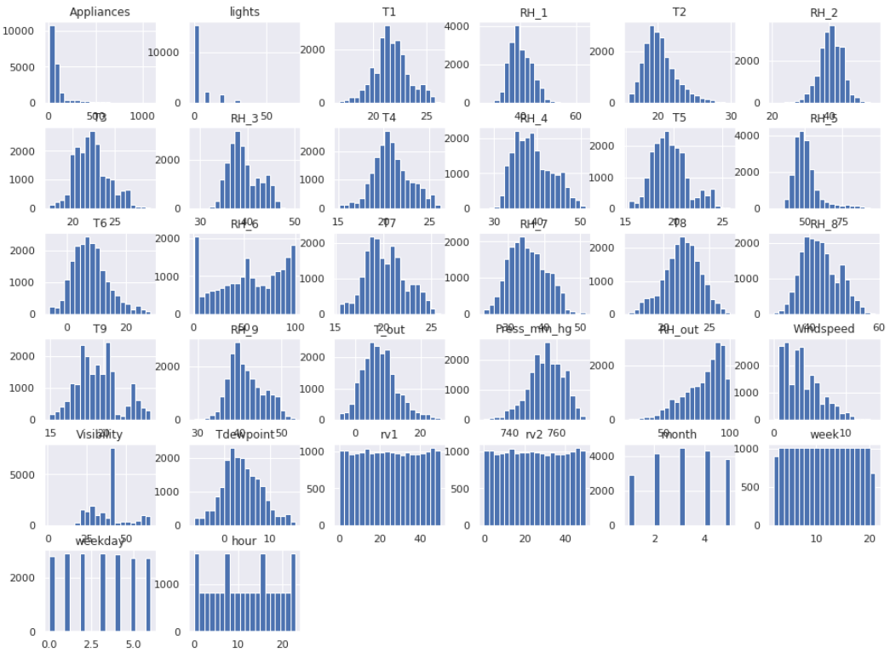
Continued:--
Except for lights, T2, RH6, RH out, wind speed, rv1 and rv2,
the rest columns are normally distributed.

Slide 11
Continued:-- Observation from previous slide
Positively skewed(>1):- Appliances, RH_5.
Moderately Positively skewed(0.5 to 1):- T2, T5, T6, T_out, RH_out, Wind speed.
Normal Distributed(-0.5 to +0.5):- T1, T3, T4, T7, T8, T9, RH_1, RH_2, RH_3, RH_4, RH_6, RH_7, RH_8, RH_9, Press_mm_hg, Visibility, Tdewpoint, rv1, rv2,
Negative skewed(-0.5 to -1):- No features.
Moderately Negatively skewed(>-1):- RH_out.

Slide 12
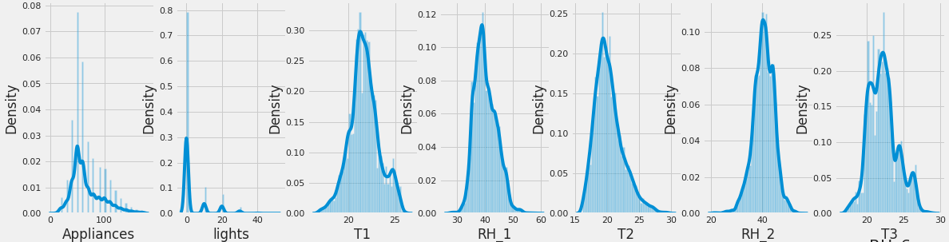
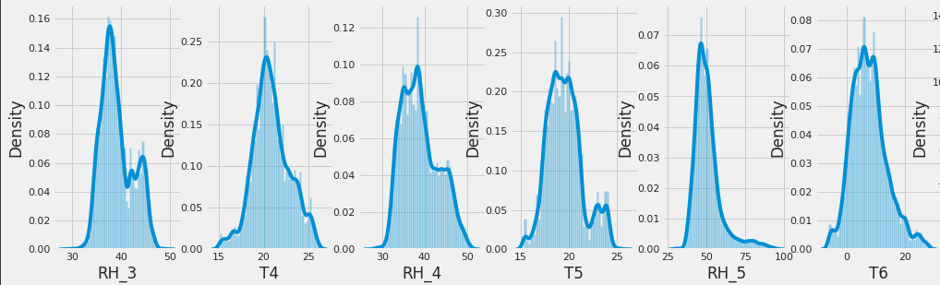
Continued:--

Slide 13
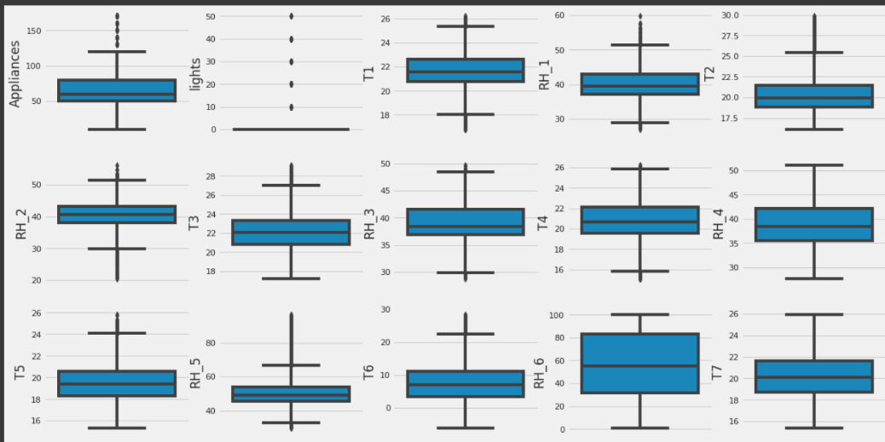
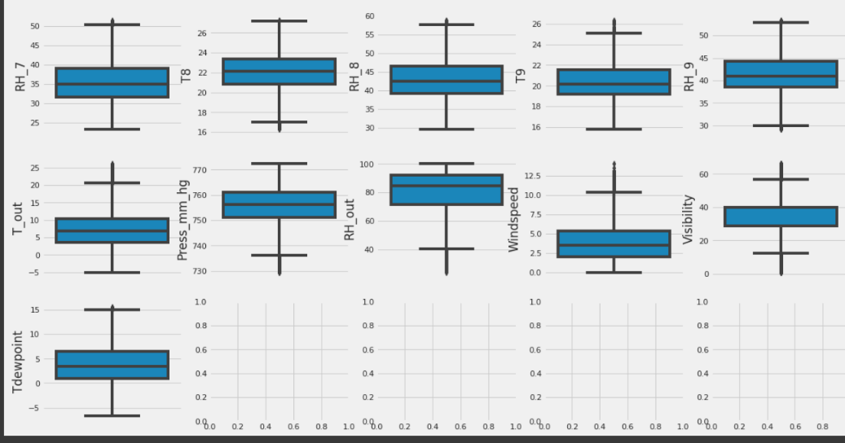
Continued:--
Boxplot for outliers for every column in the data frame.

Slide 14
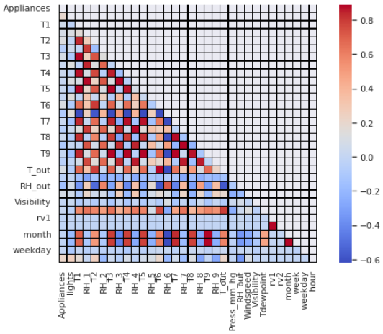
Continued:--

Slide 15
Continued:-- Observation from Heat Map
Temperature - All the temperature variables from T1-T9 and T_out have positive correlation with the target Appliances.
For the indoor temperatures, the correlations are high as expected, since the ventilation is driven by the HRV unit and minimizes air temperature differences between rooms.
Five columns have a high degree of correlation with T9 - T3,T4,T5,T7,T8 also T6 & T_Out has high correlation(both temperatures from outside) . Hence T6 and T9 can be removed from training set as information provided by them can be provided by other fields.
Weather attributes - Visibility, Tdewpoint, Press_mm_hg have low correlation values
Humidity -There are no significantly high correlation cases (> 0.9) for humidity sensors.
Random variables have no role to play

Slide 16
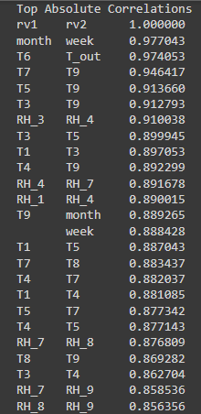
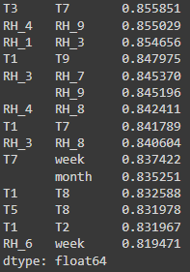
Continued:--

Slide 17
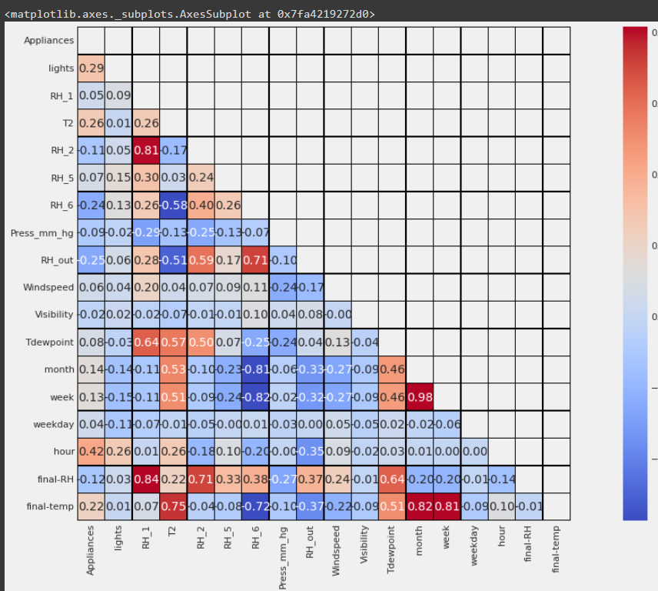
Continued: As we can see that after removing multicollinearity the data frame. This multiCollinearity is removed by taking a few portion of each column and replace to a new column.

Slide 18
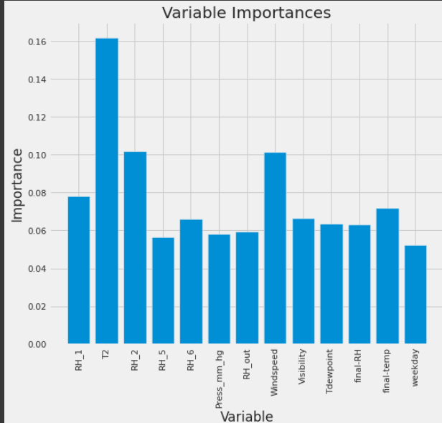
Continued:--
The next step is feature selection for increasing the model accuracy
Removing the Date and Light Column
Date dropping reason: Since we're not trying to analyze the problem as a Time Series, we shall regress on the "Appliance" column.

Slide 19
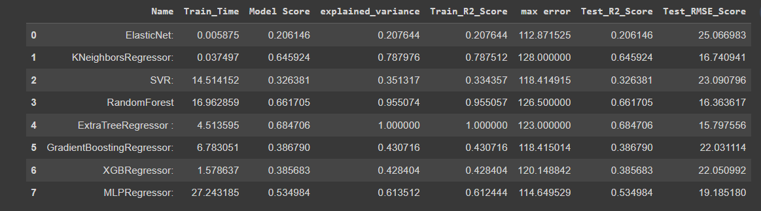
E. Applying the model:--
This table mention the value of train r2 score , Test r2 score and RMSE of the machine learning regression model.[After the Hyper Tunning]
R-squared will give you an estimate of the relationship between movements of a dependent variable based on an independent variable's movements.
Test RMSE Score tells you how concentrated the data is around the line of best fit.

Slide 20
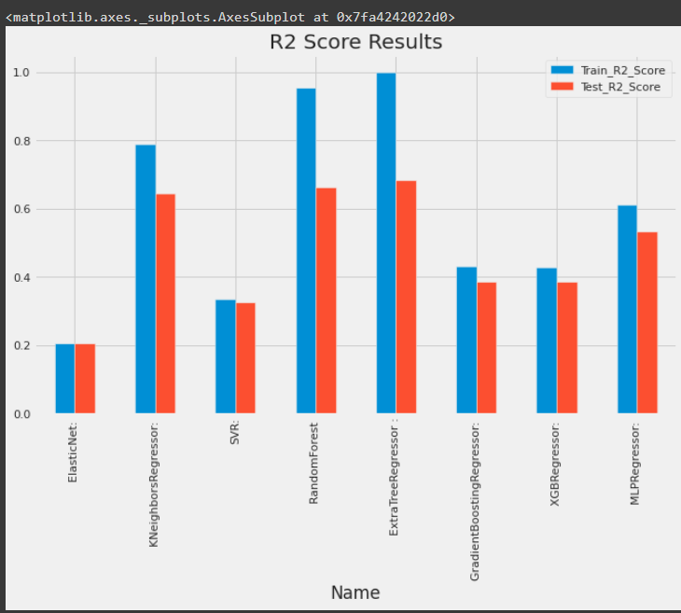
Continued:-- Representing r2 score through bar plot
From the above Data Frame, we can see that Linear Regression is not performing well at all.
Random Forest Regression is giving r2 value of 0.95 for train data and 0.66 for test data.
By comparing these models, the Random Forest regressor is performing well with a high r2 score and low MSE and RMSE values.
ExtraTreeRegressor gives an r2 _score of 1 for the training dataset and 0.68 for the test data

Slide 21
F. Conclusion:--
The project's main goal is to predict appliance energy usage. First, we analyze the data. The data set is collected at regular intervals of time, so it is time series data, but we are not implementing time series techniques on the model due to a lack of awareness of time series.
Many columns in the dataset are not normally distributed, and the target column is also right-skewed.
The dataset has many outliers and no null values.
We have a high correlation with the dependent variable in the hour column, and many features have less than a 0.1 correlation with the dependent variable in the nonlinear dataset.
Energy consumption is high in March and low in January and a rise in temperature results in higher energy consumption.
Decreased humidity leads to an increase in electricity consumption. Humidity is proportional to the dependent variable.
The most important determining factor for energy consumption is the hour of the day.
During the evening hours of 16:00 to 20:00, there is a high usage of electricity of more than 140Wh. Electricity use is highest on weekends (Saturdays and Sundays). (more than 25% higher than on weekdays)
As a feature, lights are extremely undervalued.

Slide 22


